Slide 1

Global Emission Historically
If we look at emissions throughout history until today, the outlook changes drastically.
The US and the EU both knock China off the top spot.

Slide 2
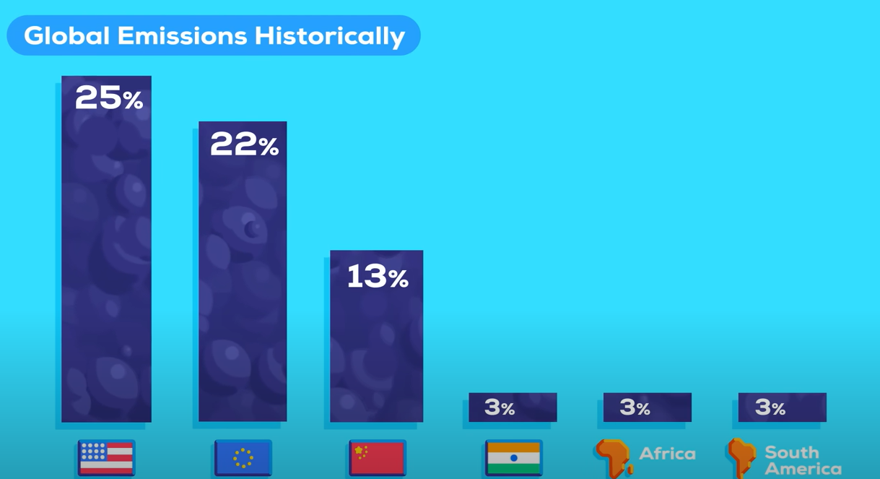
Global Emission Historically
the US is responsible for 25% of the worlds historical emissions emitting 400 billion tons, mostly in the 20th century.
In 2nd place is the EU at 22%, China comes in third at just under 13%, around half of the USA's contribution.
India's contribution shrinks to 3 percent along with the whole of Africa and South America.

Slide 3

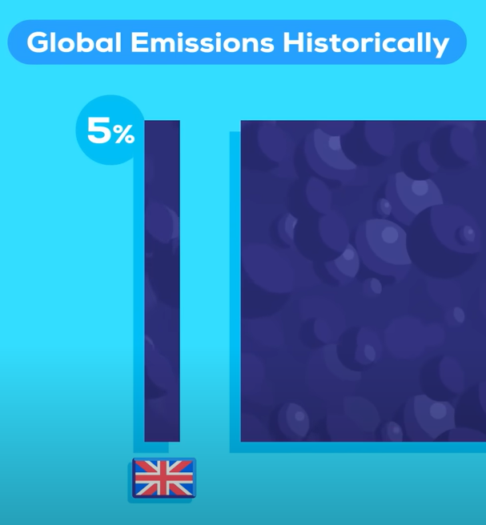


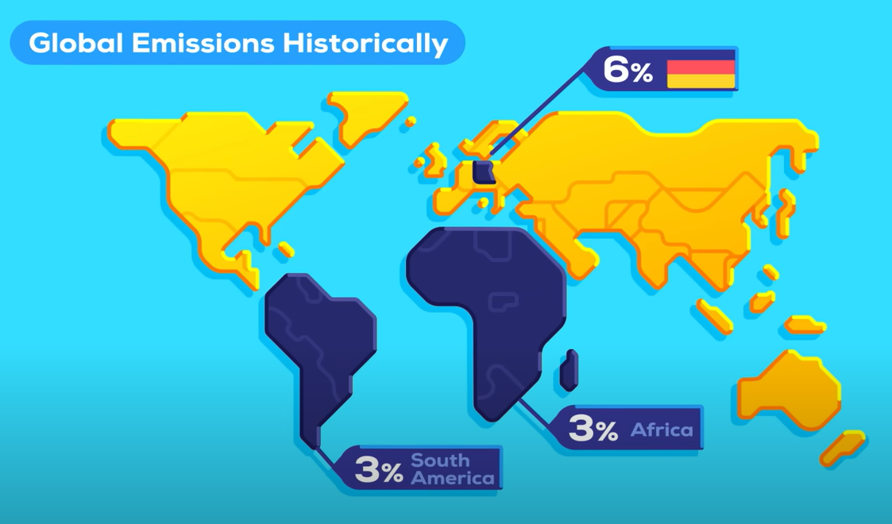
Global Emission Historically
The UK is responsible for 1% of annual global emissions but takes 5% of the historical responsibility.
Germany producing 2% of emissions per year today, has contributed almost 6% as much as the whole Africa and South America combined.

Slide 4

Global Emission Historically
So the narrative that rapid climate change is really the responsibility of the developing world is hard to defend if facts matter to you. But this is still not the whole story, because focusing on countries mixes two things:
Population numbers and total emissions. if a country has more people in general, it's emissions are of course higher.

